Slide 1
Project #0-1: Installing Pintos
[CSE4070]
Instructors
Prof. Youngjae Kim and Prof. Sungyong Park
Teaching Assistants
Hyeongu Kang
Suyeon Lee
Fall 2020
Notes:
Class PT

Slide 2
Linux Instructions and Vim Usage

Slide 3
Useful Linux instructions
man
mkdir/rmdir
cp
mv
rm
cat
echo
grep
ps
kill
pwd
su/passwd
tar
Notes:
본문

Slide 4
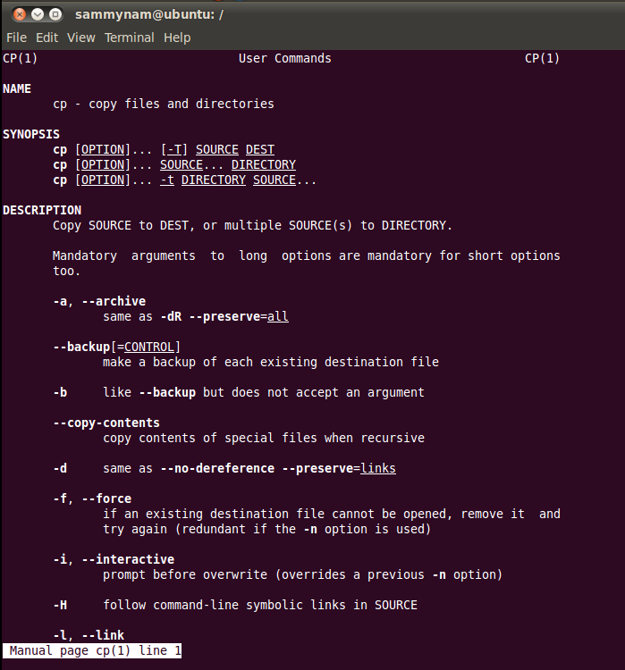
man
Provides description and usage for Linux commands
Usage: man [instruction]
Ex:
$ man cp
Notes:
본문

Slide 5
mkdir/rmdir
Make/remove directory
If the directory is not empty, use 'rm -r' to remove it
Usage: mkdir [option] [Directory Name]
rmdir [option] [Directory Name]
Ex:
$ mkdir temp
Notes:
본문

Slide 6
cp
Copy the file (Original file is preserved)
Usage: cp [option] [src] [dst]
Ex:
$ cp a.c temp
Notes:
본문

Slide 7
mv
Move file or rename file (Original file is disappeared)
Usage: mv [option] [src] [dst]
Ex:
$ mv a.c b.c
Notes:
본문

Slide 8
rm
Remove file or directory.
Usage: rm [option] [filename]
Ex:
$ rm –rf temp
If you perform 'rm -rf *' in /(root) directory, every file will be deleted from the system.
-rf option indicates recursive and force, respectively.
Notes:
본문

Slide 9
cat
1. Print the contents of the file on the standard output.
Usage: cat [option] [filename]
Ex:
$ cat tempfile
$ cat > test.txt (Get data from standard input; user can input data until user does [Ctrl+D])
$ cat < test.txt (Print the contents of the file)
2. Concatenate files
Ex:
$ cat test.txt test2.txt > test12.txt (Concatenate test.txt and test2.txt and make a file “test12.txt”)
Notes:
본문

Slide 10
echo
Prints string or system environment variables.
Usage: echo [string…]
Ex:
$ echo $PATH
$ echo x
Notes:
본문

Slide 11
grep
Print lines matching a pattern from files or standard input.
Usage: grep [option] PATTERN [File…]
-n: print the line and line number in FILE which is matched.
-i: ignore case distinctions.
-l: print only FILE name, which contains PATTERN matched.
Ex:
$ grep –n ftp /etc/groupt
$ grep –i the /etc/init.d/qmail
$ grep –il ftp /etc/init.d/*
Notes:
본문

Slide 12
ps
Report the list of current processes.
Usage: ps [option]
-ef: print the all processes with full-format listing.
-au: print the username and start time of processes including other users' processes.
Ex:
$ ps -ef
$ ps -au
Notes:
본문

Slide 13
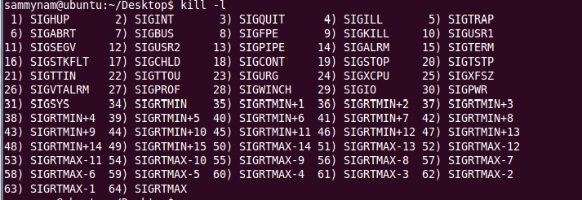
kill
Sends signal to the processes.
Representative signal is SIGKILL which is used to forcefully terminate a process.
Usage: kill [option] [process id]
-l: print list of signals
Ex:
$ kill -9 4914 (force quit process #4914)
Notes:
본문

Slide 14

pwd
Checks the current directory.
Usage: pwd
Notes:
본문

Slide 15
su/passwd
su: switch user ID or become superuser.
passwd: change user password.
Usage: su [options] [username]
Ex:
$ su (if the USERNAME is omitted than it will switch the account to the superuser.)
$ passwd (change the password of current account.)
Notes:
본문

Slide 16
tar
Compresses or extracts file.
Usage: tar [options] [pathname]
-c/x: compress / Extract
-v: verbosely list the files processed
-f: use the file to compress or extract
Ex)
$ tar -cvfz sample.tar.gz pintos (if pintos is a directory, it will be compressed into sample.tar.gz)
$ tar -xvfz sample.tar.gz (extract sample.tar.gz)
Notes:
본문

Slide 17
vim
Vim is known as Visual Interface iMproved, which is an improved version of vi
Normal mode:
yy+p: copy and paste line, /: search, x: delete character, dd: delete line, u: undo.
v : change into visual mode.
Insert mode
i : Insert, a : Append
Execution mode (Type ': (colon)' in normal mode)
w: save, q: quit, wq!: quit without saving
Insert
Exec.
esc
:
esc
i/a/o/u/s
Normal
Launch vim
Notes:
본문

Slide 18
Pintos Installation

Slide 19
Caution
We will use CSPRO9 (cspro9.sogang.ac.kr) and CSPRO10 (cspro10.sogang.ac.kr)
So do not try to run Pintos on CSPRO (cspro.sogang.ac.kr) server
Note that the CSPRO server indicates CSPRO9 or CSPRO10 from now on
Notes:
본문

Slide 20
Pintos & Emulator
Pintos is simple OS framework for 80x86 architecture.
Use system simulator that simulates an 80x86 CPU and its peripheral devices.
Project Category : Kernel Threads, User Programs, Virtual Memory, File Systems. (All projects except File Systems will be covered in this class.)
Features
Support user and kernel thread.
Allow running user program (basic UNIX commands like echo, ls, cat, pwd, …).
Support simple file system.
Implemented in C language.
Well-Documented Project & Grading System.
We will use QEMU as an emulator for Pintos.
Notes:
본문

Slide 21
Pintos Installation
Download Pintos file
We provide modified code in e-class, so don't use original source code from Stanford University.
Extract the file
$ tar -xvzf pintos_modified.tar.gz
You don't need to install QEMU in the CSPRO sever. It is already installed.
Notes:
본문

Slide 22
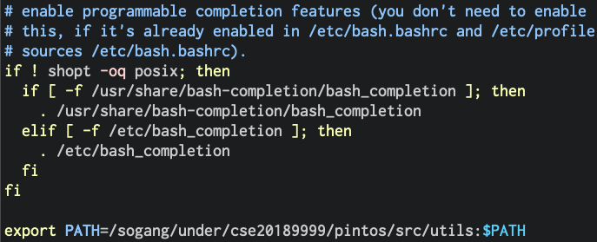
Pintos Installation
Before running Pintos, we need to setup .bashrc file in the home directory
Open ~/.bashrc with editor.
Add the following line at the end of the file: export PATH=/sogang/under/<YOUR_ACCOUNT>/pintos/src/utils:$PATH
Run the following command to apply the changes in bash shell: $ source ~/.bashrc
Notes:
본문

Slide 23
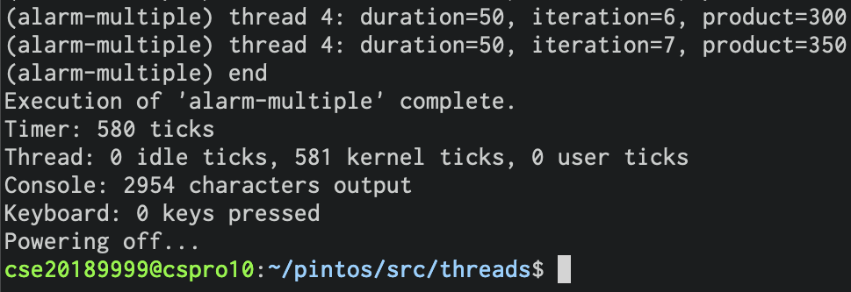
Running Pintos
Build Pintos (assume that you have already extracted the file on your home directory)
$ cd ~/pintos/src/threads
$ make
Consequently, 'build' directory will be created in the current directory (src/threads).
Run Pintos
Pintos provides 'pintos' utility that helps running Pintos by QEMU.
'pintos' utility is in src/utils.
Go to src/threads and run the following command (you should run it in src/threads, not src/utils).
~/pintos/src/threads $ ../utils/pintos -v -- -q run alarm-multiple Or ~/pintos/src/threads $ pintos -v -- -q run alarm-multiple (Note that you should input one space among '-v', '--' and '-q')
Notes:
본문

Slide 24
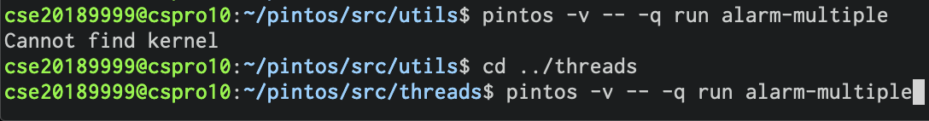
Running Pintos
If you face the error like below, check the current directory where you run pintos.
Since the current directory is src/utils, Pintos cannot find its kernel and error occurs.
If you execute Pintos in src/threads, Pintos will find the kernel in src/threads/build/kernel.bin
Notes:
본문

Slide 25
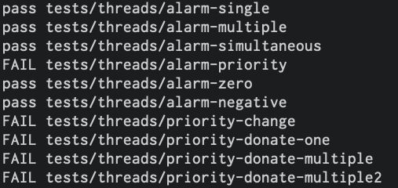
Project Test
Each project has its own test program
Test program is in src/tests.
You can use this program to test your implementation by yourself.
For example, in project 3, you can test by running 'make check' in src/threads/
~/pintos/src/threads $ make check
PASS/FAIL will be printed for each test case
※ src/threads/build/results
Notes:
본문

Slide 26
Requirements

Slide 27
Project#0-1
In CSPRO9 or CSPRO10 (not CSPRO) server, run $pintos -v -- -q run alarm-multiple and capture the result of it (you can just capture the last few lines of the result, but your ID should be shown in the capture).
If your ID is not shown in the capture, deduct 10 points. If "Powering off..." is not shown in the capture, deduct 70 points. If the Pintos doesn't quit properly (Kernel panic or other errors), deduct 70 points.
Use your own account in the server. (Don't borrow other's account.)
Due Date: 9/20 23:59 Late submission is allowed up to 3 days (~9/23) and 10% of point will be deducted per day
Submit the capture file on e-class website (Please use .jpg or .png extensions. Do not use other formats.)
File name should be the following form: os#0_1_ID#.jpg or os#0_1_ID#.png e.g.) os#0_1_20171234.jpg or os#0_1_20175678.png
Notes:
본문

Slide 28
Project#0-1
No hardcopy.
Notes:
본문

Slide 29
Reference Homepages
pintos | http://www.stanford.edu/class/cs140/projects/index.html
pintos document | http://www.stanford.edu/class/cs140/projects/pintos/pintos.pdf
Notes:
본문

